Slide 1
Southern India Regional Council - ICAI Risk based approach to Internal Audit
(Process and Execution)
CA Rekha Surana
08-11-2024

Slide 2
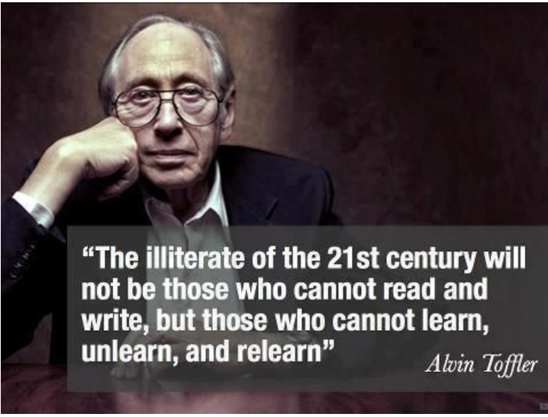
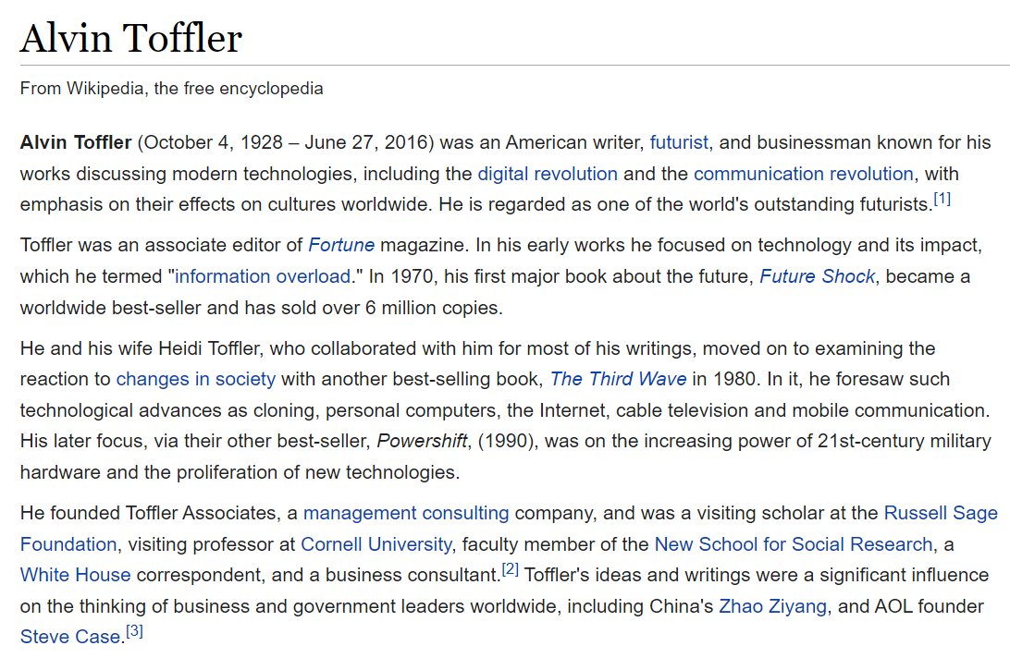
2

Slide 3
Agenda
1. Introduction to RBIA
2. Risk Management
6. Audit Report
7. Appendix- Questions
3. Risk Families ( Risks in different industries)
4. Risk Imagination- Business Process- Case Study
5. RBIA – Planning and Execution

Slide 4
Section 1: Introduction to Risk Based Internal Audit

Slide 5
Is RBIA relevant for only large organizations on complex ERP?

Slide 6
Why Risk based Internal Audit?
The Evolution of Internal Audit: shift from traditional, compliance-focused audits to a more dynamic, risk-based approach.
Benefits of RBIA:
Efficiency: Focusing resources on the areas of greatest risk.
Effectiveness: Providing more valuable insights to management.
Proactive Risk Management: Aiding in early identification and mitigation of potential problems.
Alignment with Organizational Objectives: Ensuring that audit efforts support strategic goals.

Slide 7
What is RBIA?
The Institute of Internal Auditors define Risk Based Internal Audit (RBIA) as a methodology that:
Links Internal auditing to an organization’s overall risk management framework
Allows internal audit to provide assurance to the board that risk management processes are managing risk effectively in relation to the risk appetite.

Slide 8
Internal Audit vs Risk-Based Internal Audit
Feature | Internal Audit | Risk-Based Internal Audit
Scope and Focus | Audit plan based on the audit cycle (time duration) | Audit plan based on the results of the business unit's risk evaluation. Risky areas are covered first and more frequently.
 | Focuses on compliance with P&P and the proper deployment of controls. No assessment is usually conducted on whether controls are sufficient to mitigate risks. | Starts by assessing whether controls are sufficient to mitigate risks and later tests whether these controls are properly deployed.
 | Does not aim to assess whether there are control redundancies | Focus on risks that are not properly controlled and/or overly controlled
 | Important risks might not be covered in the audit program | Provides assurance that important risks are being managed properly
Efficiency and Cost effectiveness | An understanding of business unit operations is built through a time-consuming process mapping exercise and might rely on outdated Policies and procedures | In-depth understanding of the business unit operations through risk assessment workshops and with the participation of the business unit management.
 | Internal audit resources are spread over all business units/activities | More efficient use of internal audit resources by focusing on high-risk units/areas
Objectivity | Subjective internal audit ratings; the auditor mainly relies on his judgment on the importance of each finding. | More objective ratings (findings are classified in accordance with pre-agreed risk importance criteria).

Slide 9
Section 2: Risk Management

Slide 10
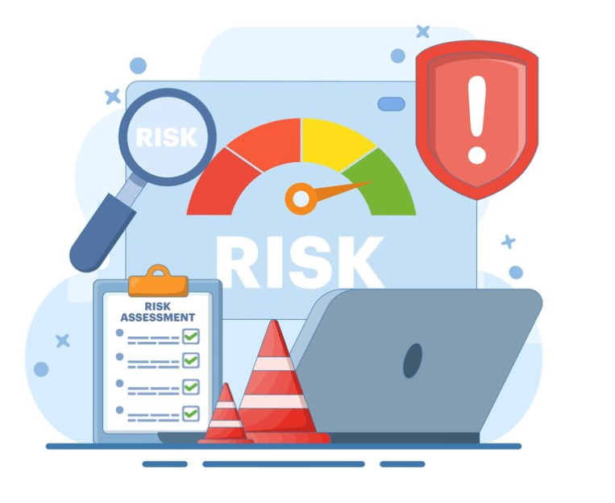
What is Risk ?
“Risk is anything that will prevent you from achieving your business objectives.”
A range of possible negative events that could take place in an uncertain environment.
Each of these events could have a significant impact on the organization and its goals.

Slide 11
What is Control ?
Control is broadly defined as ‘the combination of many factors with support of people in their efforts to achieve their business objectives’

Slide 12
Linking Risk, Controls and Objectives
Risk
Business Objectives
Desired Result/Outcome
Control

Slide 13
Linking Risk, Controls and Objectives
Risk
Business Objectives
Control
Desired Result/Outcome

Slide 14
Linking Risk, Controls and Objectives
Risk
Business Objectives
Desired Result/Outcome
Control

Slide 15
Components of Risk
R I S K
Adequately Controlled
Accepted
Insured
Source: 25th The International Turkey Internal Audit Conference

Slide 16
Strategic Risk – “What could go wrong?”
Industry Downturn
Pricing Pressure
Integration Issues
JV or Partner Issues
Customer Retention
Market Sentiments

Slide 17
Operational Risk - “What could go wrong?”
Complacency
Blind Leading Blind
Dropped Batons
ERP Implementation - GIGO
Job Profile Vs. Org. Hierarchy
Inadequate Planning.
Obsolete Production Technology
Non-Functional Infrastructure

Slide 18
Financial Risk - “What could go wrong?”
Financial Risk
Market
Volatility
Directional
Credit
Liquidity
Settlement Risk
Geography Specific
Client Specific
Asset Liquidity
Additional Financing

Slide 19
Legal Risks - “What could go wrong?”
Legal Risk
Legislative - Non compliance with applicable laws
Contractual Risk – Non compliance with Terms, Technical Faults.
Dispute Risk - Mismanagement of dispute process
Non-Contractual Risks/ Obligations - Mis-Management of IP, Social Media.

Slide 20
Risk Management
1. Risk Assessment
6. Monitoring
2. Risk Identification
5. Mitigation
3. Measurement
4. Prioritization

Slide 21
Basic Concepts of Risk Management
Risk Capacity – How much Risk the organization can absorb
Risk Appetite – How much Risk the organization is willing to accept
Risk Response – Risks cannot be completely eliminated. It can only be constrained.
Risk Register – A record of risks, risk assessments, mitigation and action plans prepared by the Management to support the ERM.
Tolerate – Cost of taking any action may be disproportionate to the potential benefit gained
Transfer – Insurance.
Terminate – Abandon the transaction
Treat – Continue the activity giving rise to the Risk action, but in a controlled manner.
Tolerate – Cost of taking any action may be disproportionate to the potential benefit gained
Transfer – Insurance.
Terminate – Abandon the transaction
Treat – Continue the activity giving rise to the Risk action, but in a controlled manner.

Slide 22
Risk Mitigation
Risk Mitigation Techniques
Terminate
Avoiding Risk
Treat
Reducing the impact and/or probability of risk occurrence
Tolerate
Retaining Risk (Acceptance)
Transfer
Passing on risk
Activity
E.g. Subcontracting
Responsibility
E.g. Insurance

Slide 23
Enterprise Risk Management
A process, affected by an entity’s board of directors, management, and other personnel, applied in strategy setting and across the enterprise, designed to identify potential events that may affect the entity, and manage risk to be within it’s risk appetite, to provide reasonable assurance regarding the achievement of objectives.
Determine the Risk
Determine the Risk Appetite (extent of risk that the Board is willing to take to pursue the objectives) – Entity Level – Process Level – Sub-Process Level
Establishing an appropriate internal environment – Risk Management Policy and Framework
Identifying potential threats to the objectives and Risk Assessment
Undertaking control activities
Communication – Information on Risks in a consistent manner
Central monitoring and Coordinating the Risk Management process
Providing assurance on the effectiveness with which risks are managed.

Slide 24
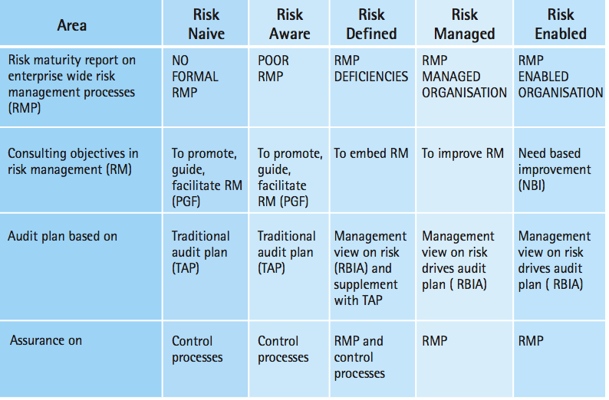
Risk Based Internal Audit
Audit is of Management of Risk and not of Risk itself.
Comment whether the process laid down for Risk Assessment is adequate and has been followed
Control Score is auditable – Domain expertise is also essential
Risk Maturity Level.
Source: ICAI Guidance Note on RBIA.

Slide 25
Section 3: Risk Families

Slide 26
Risk Families
Risk Families
Strategic Risk
Market Risk
Operational Risk
Technology Risk
Compliance risk
Financial Reporting risk
Organizational Risk
Credit Risk
Insurance Risk
Third party risk
Fraud Risk

Slide 27
Illustrative risk profile in different industries
Financial Services:
Credit Risk: Loans going into default, impacting profitability.
Market Risk: Losses from changes in interest rates, foreign exchange, or equity prices.
Operational Risk: Fraud, errors, system failures, and cybersecurity breaches.
Regulatory Risk: Non-compliance with laws like KYC (Know Your Customer), AML (Anti-Money Laundering), and data privacy regulations.
Liquidity Risk: Inability to meet short-term obligations.
Healthcare:
Patient Safety: Medical errors, infections, and adverse events.
Data Security and Privacy: Protecting sensitive patient information (HIPAA compliance).
Regulatory Compliance: Adhering to complex and evolving healthcare regulations.
Reimbursement and Billing: Denials and delays in receiving payments from insurers.
Technology Risks: Failures in electronic health records (EHR) and other critical systems.

Slide 28
Illustrative risk profile in different industries
Technology :
Cybersecurity: Data breaches, ransomware attacks, and intellectual property theft.
Disruptive Innovation: Being overtaken by new technologies and competitors.
Talent Acquisition and Retention: Attracting and retaining skilled employees in a competitive market.
Product Development: Failures and delays in bringing new products to market.
Regulatory and Legal: Compliance with data privacy, antitrust, and intellectual property laws.
Manufacturing:
Supply Chain Disruptions: Raw material shortages, transportation delays, and geopolitical instability.
Quality Control: Product defects and recalls.
Safety: Workplace accidents and injuries.
Environmental Compliance: Adhering to environmental regulations and managing waste.
Operational Efficiency: Optimizing production processes and managing costs.

Slide 29
Illustrative risk profile in different industries
Retail:
Inventory Management: Overstocking, stockouts, and shrinkage.
Competition: Pressure from online retailers and changing consumer preferences.
Customer Experience: Providing excellent service and meeting customer expectations.
Data Security: Protecting customer data and payment information.
Supply Chain: Ensuring timely delivery of goods and managing supplier relationships.
Energy:
Price Volatility: Fluctuations in oil, gas, and electricity prices.
Environmental Risks: Climate change, emissions, and spills.
Safety: Accidents and injuries in hazardous work environments.
Regulatory Compliance: Adhering to complex environmental and safety regulations.
Geopolitical Risks: Political instability and conflicts in energy-producing regions.

Slide 30
Section 4: Risk Imagination- Business Process- Case Study

Slide 31
Case Study – Risk Imagination
Key Business processes
Order to cash
Procure to pay
HR & Payroll
Fixed Assets
Treasury
Governance Controls

Slide 32
Risk Imagination- Order to Cash
Risks:
Incorrect order entry
Inaccurate credit assessment
Unauthorized order
Unauthorized discounts
Incorrect product shipments / delayed shipments
Stock out situations
Unauthorized refunds / returns
Incorrect invoicing
Pricing error
Misapplied Payments
Aged receivables / Bad Debts
Incorrect Revenue Recognition
Weak IT general controls
Fraud Risks:
Fictitious order
Manipulating Credit checks / extending credit to unqualified customer
Fictitious invoice / Ghost shipments
Skimming of Cash
Fictitious revenue recognition

Slide 33
Risk Imagination- Procure to Pay
Risks:
Unauthorized Purchases
Budget overruns
Receiving unordered goods
Shortage of goods
Quality Issues
Commodity Price Fluctuations
Freight Channel Disruption
Variance in quantity ordered vs quantity delivered
Variance in agreed pricing and invoiced pricing
Duplicate Payments
Error in data entry
Unauthorized / untimely Payments
Continuous purchase from single source supplier / Absence of back up Supplier
Inadequate segregation of duties
Inadequate of Contract Management
Lack of performance monitoring
Weak IT general controls
Non compliance to related laws and regulations
Fraud Risks:
Fictitious vendor
Unauthorized purchases
Selection of incompetent vendors / favoritism
Collusion of vendor with employees
Personal purchases
Product substitution
over invoicing
Duplicate invoicing
Ghost Shipping (ordering goods that were never delivered)
Vendor Kickbacks / bribes
Bid Rigging
Manipulation of vendor information
Transaction with Related party not in arms length

Slide 34
Risk Imagination- Human Resources and Payroll
Risks:
Hiring Unqualified or Inappropriate Candidates
Inaccurate time recording
Incorrect payroll calculations leading to over payments / underpayments
Non compliance to statutory requirements (Like Factories Act, Provident Fund, ESI, Gratuity, Minimum wages, etc.)
Unapproved paid leave
Excess claim of Benefits
Inaccurate performance evaluations
Unauthorized access to payroll system
Weak IT general controls
Data privacy breach
Unapproved Loans
Unapproved reimbursements
Unapproved increase in Salary / Promotions
Fraud Risks:
Ghost Employee
Buddy punching
Falsified timesheet
False claim of benefits
Manipulation of Incentive and Bonus Computation
Falsified Expenses
Duplicate claim of Reimbursement
Falsified referral claims

Slide 35
Risk Imagination- Fixed Assets
Risks:
Unauthorized Purchases
Inaccurate recording in books of accounts
Unauthorized capitalization
Incorrect depreciation calculation
Inadequate impairment provision
Failure to retire obsolete assets
Underestimate of useful life
Overstatement of asset value
Duplicate Invoicing
Discrepancies between physical and recorded assets
Capitalization of Maintenance cost
Weak IT general controls
Fraud Risks:
Fictitious Assets
Unauthorized disposal
Other Risk of Procure to Pay shall be applicable

Slide 36
Risk Imagination- Treasury
Risks:
Inefficient cash forecasting
Idle cash
Unauthorized transfers
Poor investment decisions
Overleveraging
Exposure to foreign exchange risk
Poor bank relationships
Inadequate hedging strategies
Unauthorized intercompany loans / investments
Weak IT general controls
Fraud Risks:
Fraudulent transaction
Fictitious cash flow projections
Forged Cheques
Phishing Attacks
Ponzi Schemes
Embezzlement of cash
Overstating Hedge Effectiveness
Misallocation of Loan repayments
Unauthorized alteration of banking credentials

Slide 37
Risk Imagination- Governance Risks
Risks:
Ineffective board leadership
Conflict of Interest
Inadequate risk identification and risk assessment
Noncompliance with laws and regulations
Lack of segregation of duties
Inadequate internal controls
Inadequate data access control
Unauthorized related party transaction
Suppression of Whistle blower complaints
Fraud Risks:
Insider Trading
Manipulation of Performance Metrics
Concealment of Material misstatement
False reporting
Non arms length transaction with related party
Concealment of related party relationships

Slide 38
Section 5: RBIA- Planning and Execution

Slide 39
Elements of RBIA
Reporting
Execution
Planning

Slide 40
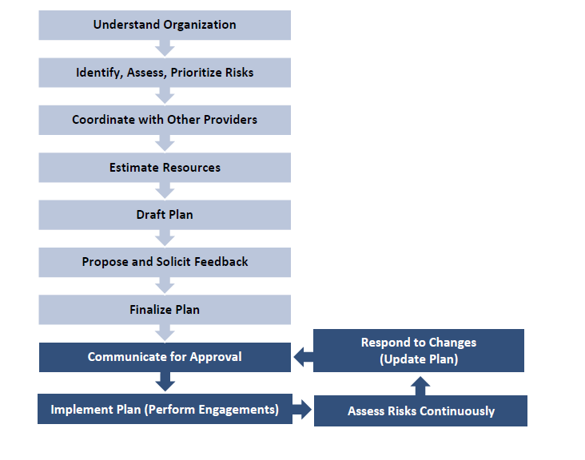
Developing a Risk Based Internal Audit Plan
Source: The IIA- Developing a Risk-based Internal Audit Plan
Source: The IIA- Developing a Risk-based Internal Audit Plan

Slide 41
Sources of Emerging Risks
Changes in management priorities, business processes, technology (IT), and operations.
Ethics/whistleblower system for fraud risks.
Geopolitical developments.
Legal and regulatory changes.
Requests from senior management and the board.
New projects and change programs.
Prior risk assessments from management and internal audit activity (including fraud, IT, and financial controls).
Source: The IIA- Developing a Risk-based Internal Audit Plan

Slide 42
Execution
Compliance Testing:
These tests provide the necessary evidence to ensure that controls are properly applied (as described by management)
2) Substantive Testing:
They are tests for operations, account balances, and other tests (such as analytical review) that aim to obtain evidence of the degree of completeness, existence, and the accuracy of the data in the accounting records or financial systems. They are used to examine areas where internal controls are considered weak to establish whether the risks that the controls were intended to mitigate have actually occurred.

Slide 43
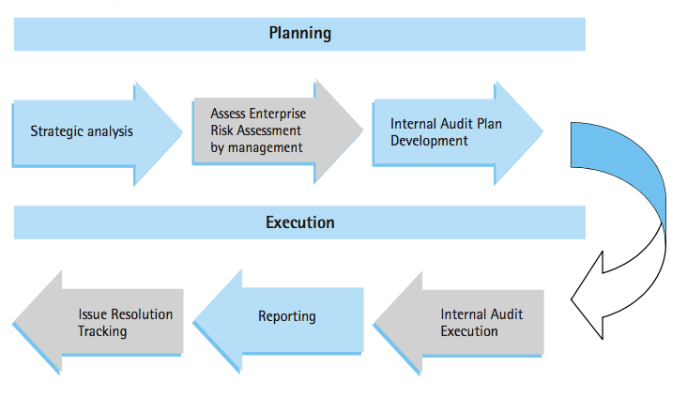
Internal Audit Process
Source: ICAI Guidance Note on RBIA.

Slide 44
Risk Heat Map
Catastrophic | M | H | H | E | E
Major | L | M | H | H | E
Moderate | L | M | M | H | H
Minor | L | L | M | M | M
Insignificant | L | L | L | L | M
 | Remote | Unlikely | Possible | Likely | Almost Certain
Consequence
Likelihood
Legend | Low | Medium | High | Extreme
Source: ICAI Guidance note on RBIA

Slide 45
The Three Lines Model
Control
Environment
1st Line : Staff are “Risk Owners”, they have direct responsibility for the management and control of risk. They participate in CRSA workshops and conduct self assessment tests
2nd Line : Risk Management monitors risks that can breach the boards appetite (tolerance level) and monitor KRIs. Compliance monitors Legal/Regulatory risks.
3rd Line : Internal Audit provides independent assurance in respect of the integrity and effectiveness of the risk management framework
Third Line
Internal Audit
Monitoring Activities
Risk Assessment
Second Line
Risk Management and compliance
First Line
Lines of business and committees
Information and Communication
Control Activities
Source: Adapted from EIICA/ FERMA Guidance on the Eighth EU Company Law Directive, Article 41

Slide 46
Components of Risk - Revisited
R I S K
Adequately Controlled
Accepted
Insured
Working Gap
Actual Gap
Source: 25th The International Turkey Internal Audit Conference

Slide 47
Section 6: Audit Report

Slide 48
Audit Report Contents
Background of the Observation
Specific Location
Area of Audit
Observation in Brief
Impact Analysis
Financial
Operational
Compliance
Root Cause Analysis
People
Technology
System Design
Assessment
Design Gap – Absence of Control
Operating Ineffectiveness
Conclusion
Possible Solution
Timeline
Responsibility

Slide 49
Illustrative example of Audit Report:
Audit Report format

Slide 50
Illustrative example of Risk and Control Library:
Risk and Control Library

Slide 51
Enhancing RBIA
Emerging Risks: Discuss how to incorporate emerging risks (e.g., cybersecurity, data privacy, sustainability) into the audit plan.
Data Analytics: Explain the use of data analytics in RBIA for continuous auditing, fraud detection, and more efficient testing.
Fraud Risk: How internal audit assesses and responds to the risk of fraud within the organization. (IIA Practice Guide: Internal Auditing and Fraud)

Slide 52
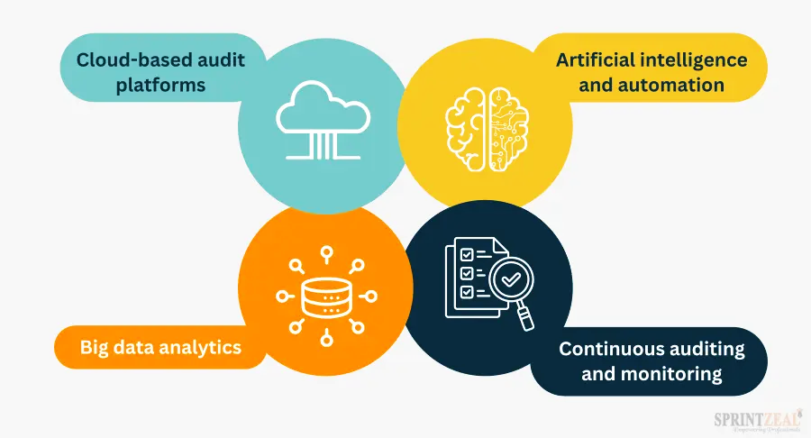
The Future of Risk Based Audit
Source: sprintzeal.com - A Comprehensive Guide to Building Risk-Based Internal Audit Plan

Slide 53
Suggested Reading
ICAI- Guide on Risk Based Internal Audit
ICAI- Technical Guide on Risk-based Internal Audit in banks (2024 edition)
ICAI-Internal Audit Checklist
ICAI-Internal Audit-Industry Specific guides
ICAI-Standards on Internal Audit
ICAI-Forensic Accounting and Investigation Standards

Slide 54
Section 7: Appendix - Questions

Slide 55
Question (1) What is the primary objective of a risk-based internal audit approach?
a) To ensure compliance with all applicable laws and regulations
b) To identify and assess the organisations most significant risk
c) To provide assurance on accuracy of financial statements
d) To eliminate all risks faced by the organisation

Slide 56
Question (2) Which of the following is NOT a key component of the risk assessment process?
a) Identifying potential risks
b) Analyzing the likelihood and impact of risks.
c) Developing audit procedures.
d) Evaluating the effectiveness of risk responses.

Slide 57
Question (3) How does internal audit prioritize audits in a risk-based approach?
a) Identifying potential risks
b) Analyzing the likelihood and impact of risks.
c) Developing audit procedures.
d) Evaluating the effectiveness of risk responses.

Slide 58
Question (4) Which of the following is an example of an emerging risk that internal audit should consider?
a) Cybersecurity threats
b) Changes in government regulations
c) Disruptions to the supply chain
d) All of the above

Slide 59
Question (5) How can data analytics be used to enhance the risk-based internal audit process?
a) By automating repetitive tasks and freeing up auditors for more complex analysis
b) By identifying anomalies and trends that may indicate fraud or errors
c) By providing real-time insights into organizational risks
d) All of the above

Slide 60
Question (6) What is the role of internal audit in relation to fraud risk management?
a) To prevent all instances of fraud within the organization
b) To assess the effectiveness of fraud prevention and detection controls
c) To investigate all suspected fraud cases
d) To prosecute employees who commit fraud

Slide 61
Question (7) Which of the following is a benefit of using a risk-based internal audit approach?
a) Improved efficiency by focusing resources on high-risk areas
b) Enhanced ability to provide valuable insights to management
c) Stronger alignment with organizational objectives
d) All of the above

Slide 62
THANK YOU FOR INVESTING
YOUR TIME
Disclaimer
The information contained in this document prepared by the speaker and is furnished to the recipient, on his/ her specific request and for information purpose only. In no way, this document should be treated as a marketing material or efforts to solicit a client. The sole purpose of the material is to impart knowledge. The trade marks, designs, contents, references etc., used in this document does not belong to the speaker. Due credit is given to the source of information wherever used.
While we have made every attempt to ensure that the information contained in this document is true, the speaker or the firm he represents or, its partners and/or any of its employees does not give any warranty, express or implied, including the warranty of opinions expressed for a particular purpose, or assume any liability or responsibility for the accuracy, completeness, or usefulness of any information available from this document. The recipient of this document specifically agrees and acknowledges that all proprietary rights in the information available on this document for all times shall remain the property of speaker. Reproduction, redistribution and transmission of any information obtained from this document is strictly prohibited. Speaker shall not be liable for any claims or losses of any nature, arising directly or indirectly from use of the data or material or any information in this document. Use of this document is confirmation that you understand and accept these terms.
Disclaimer
The information contained in this document prepared by the speaker and is furnished to the recipient, on his/ her specific request and for information purpose only. In no way, this document should be treated as a marketing material or efforts to solicit a client. The sole purpose of the material is to impart knowledge. The trade marks, designs, contents, references etc., used in this document does not belong to the speaker. Due credit is given to the source of information wherever used.
While we have made every attempt to ensure that the information contained in this document is true, the speaker or the firm he represents or, its partners and/or any of its employees does not give any warranty, express or implied, including the warranty of opinions expressed for a particular purpose, or assume any liability or responsibility for the accuracy, completeness, or usefulness of any information available from this document. The recipient of this document specifically agrees and acknowledges that all proprietary rights in the information available on this document for all times shall remain the property of speaker. Reproduction, redistribution and transmission of any information obtained from this document is strictly prohibited. Speaker shall not be liable for any claims or losses of any nature, arising directly or indirectly from use of the data or material or any information in this document. Use of this document is confirmation that you understand and accept these terms.
Notes:
Photos by rawpixel.com / Freepik

